Slide 2
Objectives
Describe the origins of electronic business transactions, including the electronic funds transfer (EFT) system, the electronic data interchange (EDI) standard, and value-added networks (VANs)
Discuss unique e-business factors and identify e-businesses that use them

Slide 3
Objectives
Define common e-business models and explain how each model generates revenue
Describe the e-retailing storefront software, merchant accounts, and payment-processing services needed to create and operate an online store

Slide 4
E-Business Origins
Electronic business activities originated in the 1960s and 1970s

Slide 5
E-Business Origins
Electronic Funds Transfer (EFT)
Allows the electronic exchange of money between banks – without the exchange of paper currency – via the Automated Clearing House (ACH) network
Electronic Data Interchange (EDI)
Standard that specifies the layout or format a company uses to exchange electronic business data with its suppliers and customers
Participants in EDI are called trading partners
Before the Internet, used value-added networks (VANs)

Slide 6
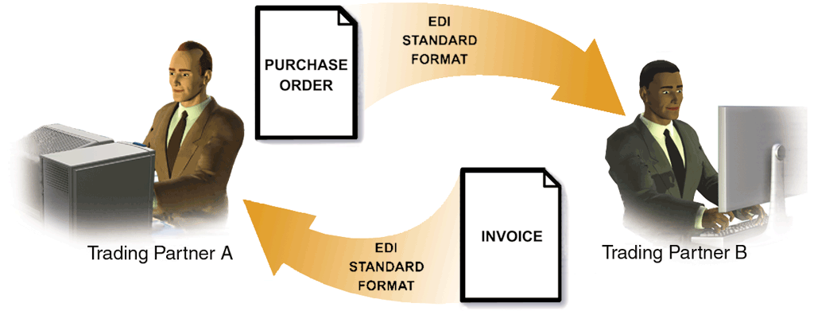
E-Business Origins

Slide 7
E-Business Origins
Electronic Data Interchange (EDI) (continued)
Grid computing combines resources from many sources to reach a common goal
Distributed computing, related to grid computing, refers to combining many networked computers and devices to create a virtual super computer that can perform complex tasks
Cloud computing is a type of distributed computing

Slide 8
Unique E-Business Factors
E-business advantages include worldwide sales opportunities, reduced transaction and purchasing costs, and access to small, niche markets
Other unique e-business factors include
Geography, time, and space on the online marketplace
The network effect
Redefining markets
Personalization and customization

Slide 9
Unique E-Business Factors
Geography, Time, and Space
Geography, time, and space are limiting factors for brick-and-mortar businesses
Geography – Physical location must be near potential customers
Time – Operating hours may be limited to peak shopping hours
Space – Inventory is limited to storage and shelf space

Slide 10
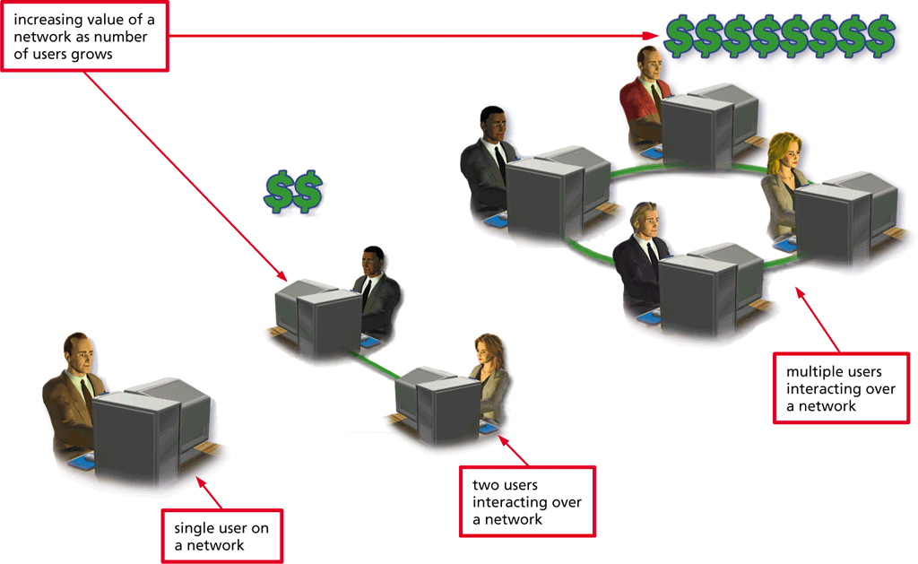
Unique E-Business Factors
The Network Effect
The network effect refers to the increasing value of a network as it grows
Network becomes more valuable to its users as more a nd more users connect to it

Slide 11
Unique E-Business Factors
Redefining Markets
Market redefinition usually takes place in one of two ways
By removing traditional marketplace intermediaries (disintermediation)
By creating new ways to add value to business transactions, often by introducing new types of intermediaries (reintermediation)

Slide 12
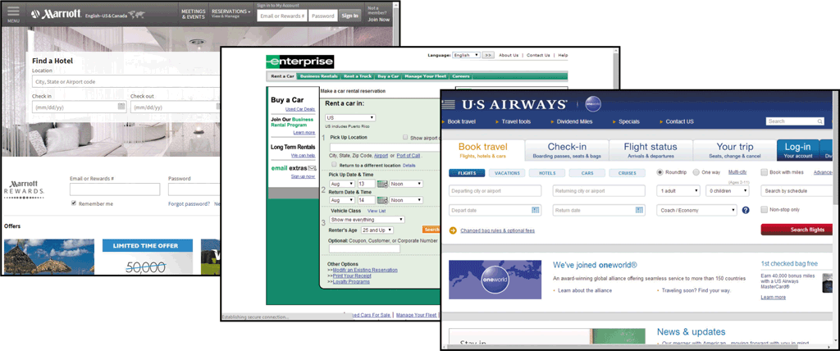
Unique E-Business Factors
Redefining Markets (continued)
Disintermediation occurs when a market removes its traditional intermediaries
Computer industry (Dell)
Travel industry

Slide 13
Unique E-Business Factors
Redefining Markets (continued)
Reintermediation occurs when an e-business introduces a new type of intermediary into the marketspace
Dell, Hewlett-Packard, and other online versions of stores
Orbitz and Hotels.com in the travel industry

Slide 14
Unique E-Business Factors
Personalization and Customization
Personalization is an automatic process that tailors webpage content to fit the profile of a specific target audience, or that automatically tailors webpage content for an individual visitor based on his or her actions at a site
Customization is a manual process that allows a viewer to manage webpage content by selecting viewing preferences or by creating and updating a personal profile

Slide 15
E-Business Models
Exactly how a commercial website generates revenue might not be obvious
Business model is the way a company operates to generate revenue, create profits (the excess of revenue over expenses), and continue as a viable business entity
Individual e-businesses optimize factors such as geography, time, space, the network effect, personalization, and customization within the framework of their e-business model

Slide 16
E-Business Models

Slide 17
E-Business Models
E-businesses often operate using a mix of e-business models and revenue-generation methods
Offering subscription-based content
Selling advertising space
Earning referral fees by providing links to other e-businesses
Selling proprietary e-business technologies
Providing a channel for business partners
Participating in an affiliate marketing program

Slide 18
E-Business Models
Business-to-Consumer (B2C)
E-retail business model that generates revenues by
Selling products and services directly to consumers
Selling website advertising space
Charging subscription or memberfees for premium content
Most traditional brick-and-mortar retailers and catalog merchants now are brick-and-click e-retailers

Slide 19
E-Business Models
Business-to-Consumer (B2C) (continued)
Pure-play e-retailers operate only online
Niche market is a small segment within a larger market and enables some pure-play e-retailers to succeed by avoiding competition with larger e-businesses
Advertising Revenues – some B2C e-businesses offer free content (apps, information, links games, etc.) and generate revenue by selling advertising at their sites
Go directly to advertised website by clicking a click-through
Per-click revenue method
Cost per impression (CPI) method

Slide 20
E-Business Models
Business-to-Consumer (B2C) (continued)
Subscription Fees – Another way for B2C e-business to generate revenue involving fees for premium content or an app

Slide 21
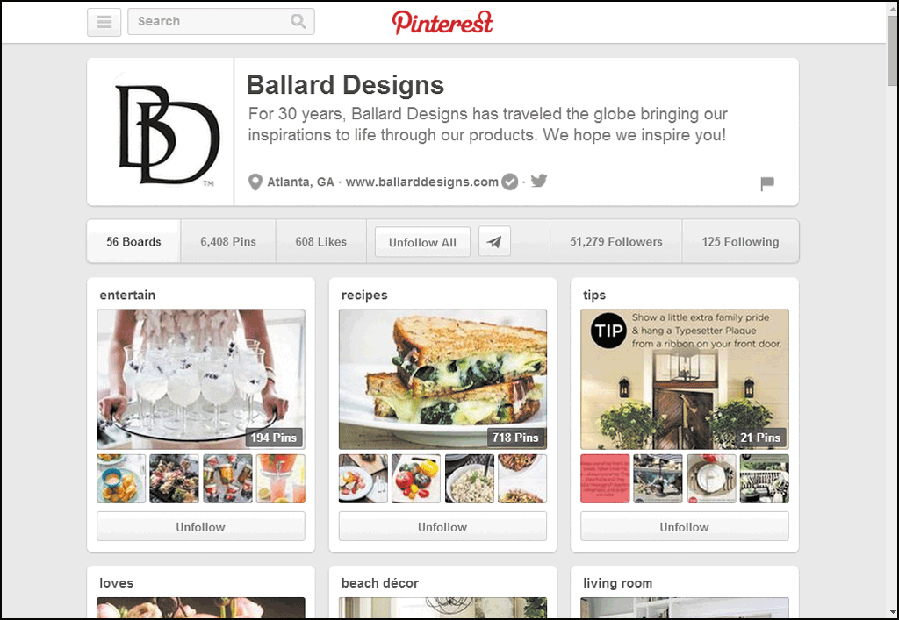
E-Business Models
Business-to-Consumer (B2C) (continued)
Businesses use social media to promote individual businesses and specific industries, to sell products and services, or to generate revenue by selling advertising space
Businesses use social media to show pictures and links to products

Slide 22
E-Business Models
Consumer-to-Business (C2B)
Allows a buyer to name his or her own price for specific goods or services which are then presented to multiple sellers (reverse auction)
When a seller accepts a buyer’s offer, the buyer’s credit card is immediately charged
Revenues are generated via booking fees and commissions on accepted offers

Slide 23
E-Business Models
Consumer-to-Consumer (C2C)
Brings individual buyers and sellers together in an online marketspace (forward auctions)
Generates revenues via transaction fees, sales commissions, subscription fees, and personal ad fees
Some allow members to exchange items of equal value
Generate revenue via small subscription or membership fee, advertising, or charging for extra services

Slide 24
E-Business Models

Slide 25
E-Business Models
Business-to-Business (B2B)
Transactions account for largest share of total e-business revenue
B2B e-business models generate revenues in a number of ways
Business directory listing fees
Website advertising
Subscription or membership fees
Referral fees
Transaction fees

Slide 26
E-Business Models
Business-to-Business (B2B) (continued)
B2B e-business models generate revenues in a number of ways
Sales commissions
Website hosting fees
File storage fees
Software licensing and rental fees
Affiliate marketing programs

Slide 27
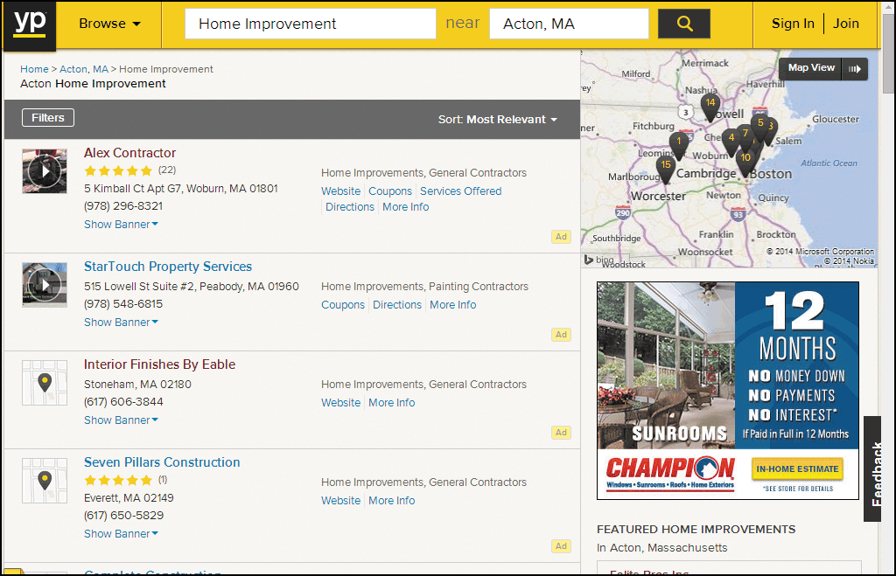
E-Business Models
Business-to-Business (B2B) (continued)
Some B2B e-businesses aggregate business information and generate revenue from directory listing fees and advertising

Slide 28
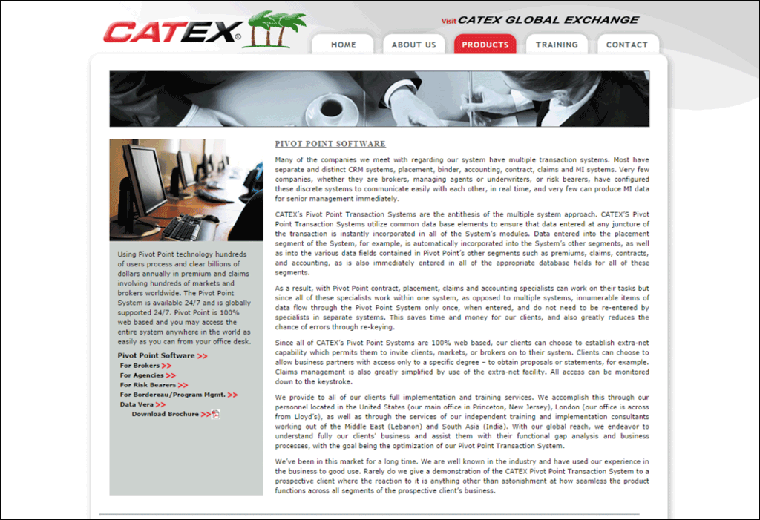
E-Business Models
Business-to-Business (B2B) (continued)
B2B Exchanges -- create online marketspaces in which businesses can buy and sell with each other following predetermined exchange rules.

Slide 29
E-Business Models
Business-to-Business (B2B) (continued)
Affiliate Marketing Programs
Affiliate marketing program is a referral marketing program designed to drive visitor traffic to a website
Affiliate marketing program participant, sometimes called associate, adds a link to the e-business website from own website
Associate earns a commission or referral fee when viewer clicks-through to the sponsoring e-business’ website; sometimes earns more if the visitor makes a purchase
Amazon Associates program

Slide 30
E-Business Models
Business-to-Business (B2B) (continued)
Technology Providers
Portion of total B2B e-business is conducted between e-businesses and their technology providers
ISPs (Internet service providers) and NSPs (network service providers) provide the Internet communications infrastructure (AOL, Verizon, Comcast, AT&T)
Other technology providers develop and sell the networking hardware and software that enables online business activities (Oracle, Microsoft, IBM, HP, SAP, and Cisco Systems)
E-businesses that sell their proprietary technologies to other e-businesses

Slide 31
E-Business Models
Business-to-Business (B2B) (continued)
Technology Providers
Web hosting companies provide web and database server storage and server administration services
Shared hosting – multiple e-businesses share a single web server owned by the hosting company
Dedicated hosting – exclusive use of an entire server(s)
Colocation – e-business have their own servers, yet contract with web hosting to store their servers at the host’s facility
Managed hosting – web hosting company builds, customizes, manages, and supports dedicated e-business servers for clients, who pay a flat monthly fee

Slide 32
E-Business Models
Business-to-Business (B2B) (continued)
Technology Providers
Online storage service uses remote server or the cloud to store data
Application service provider (ASP) develops and maintains its own business application software
Employee collaboration software allows employees to share documents, calendars, contacts, and other information
Content delivery network (CDN) is a dedicated network of servers located in different geographical areas of the country that store, or cache, webpage content from high-traffic websites for a fee

Slide 33
E-Business Models
Business-to-Business (B2B) (continued)
Supply Chain Management
A supply chain consists of all the entities involved in creating and distributing products to end users
Many transactions are conducted over an extranet, which is a private network that uses Internet technologies to connect a business with its suppliers and business partners
Less expensive option than value-added networks (VANs)

Slide 34
E-Business Models
Business-to-Government (B2G)
Online businesses that market and sell directly to government agencies
Creates a marketspace, similar to B2B exchange, that provides businesses with information on bidding opportunities for government agency contracts
Sells technologies to manage the bidding and procurement process

Slide 35
Creating an Online Store
Thousands of men and women become e-business entrepreneurs by starting and operating an online business
Famous and successful e-business entrepreneurs
Evan Williams (Twitter)
Jeff Bezos (Amazon.com)
Michael Dell (Dell, Inc.)
Reed Hastings (Netflix)

Slide 36
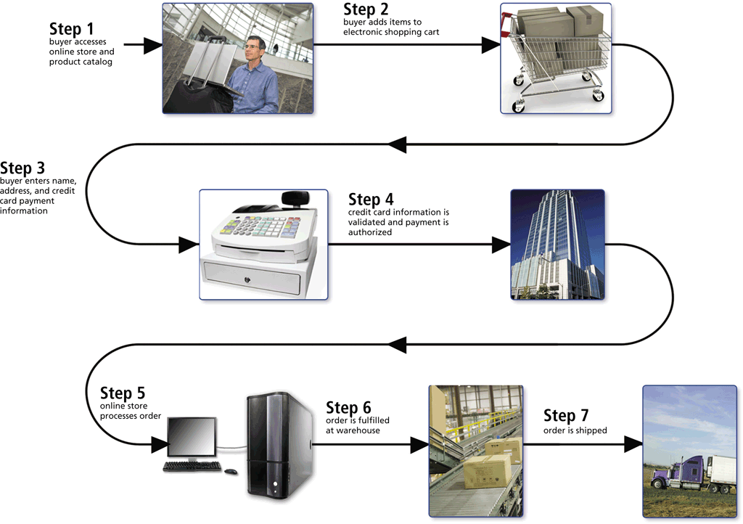
Creating an Online Store
Storefront Software
A typical e-retail transaction consists of several steps

Slide 37
Creating an Online Store
Storefront Software (continued)
Storefront software (also called e-commerce software) provides tools to build and maintain webpages and the underlying product databases
Also contains shopping cart software that tracks items selected for purchase and handles the checkout process
Summarizing the order
Calculating shipping and taxes
Calculating the total order
Processing the payment

Slide 38
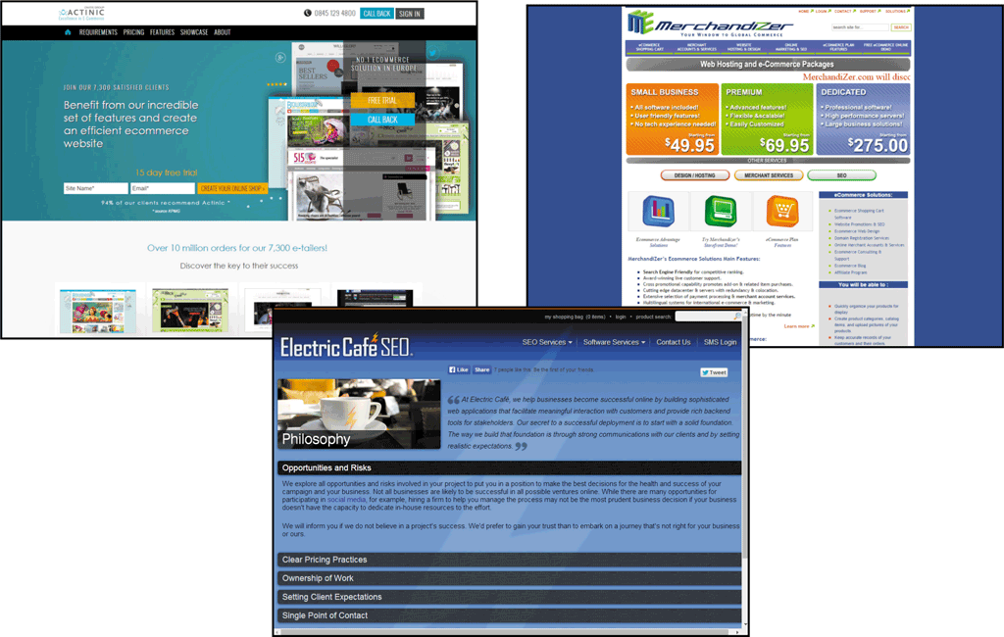
Creating an Online Store
Storefront Software (continued)
Installed storefront software is customizable software that resides on an e-retailer’s web server

Slide 39
Creating an Online Store
Storefront Software (continued)
Hosted storefront software uses webpage templates that allow you to create a store and add products to your online catalog
May have fees
Some vendors provide software demos or allow review of their software on a free trial basis

Slide 40
Creating an Online Store
Credit Card Authorization and Processing
Many online purchases are paid for by credit card
Third-party payment processors
PayPal
Google Wallet
An e-retailer that accepts credit cards must have two things
Account for credit card receipt deposits
Service that authorizes and processes credit card transactions

Slide 41
Creating an Online Store
Credit Card Authorization and Processing (continued)
Merchant account is an e-business account with a financial institution that stores money from credit card purchases
Any business that accepts credit cards must have merchant account
Can withdraw funds, but only can deposit credit card receipts

Slide 42
Creating an Online Store
Credit Card Authorization and Processing (continued)
Fees might include
Setup fees
Monthly access fees
Per-item transaction fees
Discount rate, which is the percentage of each transaction that the financial institution will charge the e-business

Slide 43
Creating an Online Store
Credit Card Authorization and Processing (continued)
Fees for merchant account depend on the financial institution’s perceived risk of doing business with the e-business
Chargeback – return of funds for to a credit card company resulting from a card holder’s refusal to pay a charge
Card not present/card holder not present risk increases the risk of credit card fraud and potential chargebacks

Slide 44
Creating an Online Store
Credit Card Authorization and Processing (continued)
An online store must be able to connect to a payment-processing service that can verify, authorize, and process secure credit card transactions
Some vendors offer online payment-processing services, called payment gateways

Slide 45
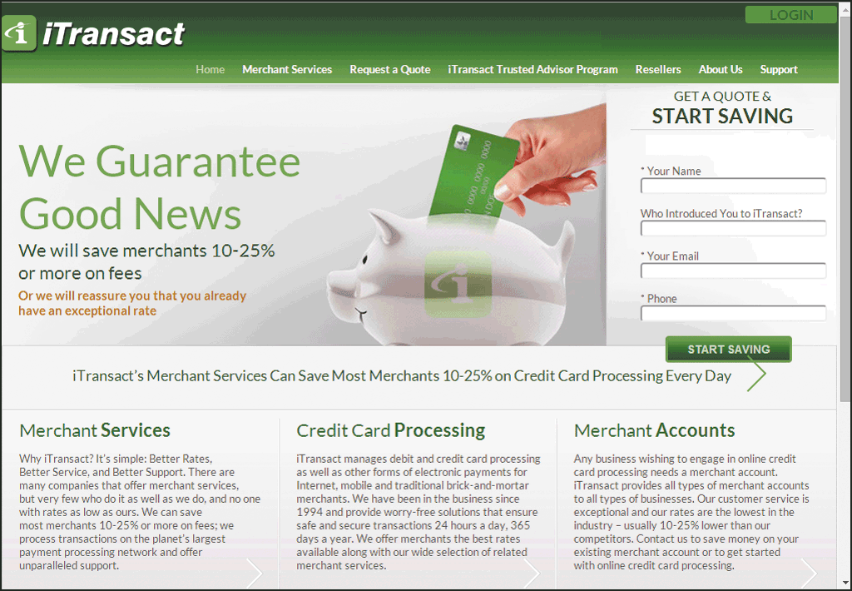
Creating an Online Store

Slide 46
Creating an Online Store
Credit Card Authorization and Processing (continued)
When selecting storefront software, a payment gateway, and merchant account, be certain all three are compatible.
Order fulfillment is the process e-retailers have for packaging and shipping products
Many e-retailers save time and money by using third-party fulfillment or logistics companies

Slide 47
Summary
Describe the origins of electronic business transactions, including the electronic funds transfer (EFT) system, the electronic data interchange (EDI) standard, and value-added networks (VANs)
Discuss unique e-business factors and identify e-businesses that use them

Slide 48
Summary
Define common e-business models and explain how each model generates revenue
Describe the e-retailing storefront software, merchant accounts, and payment-processing services needed to create and operate an online store

